Slide 1
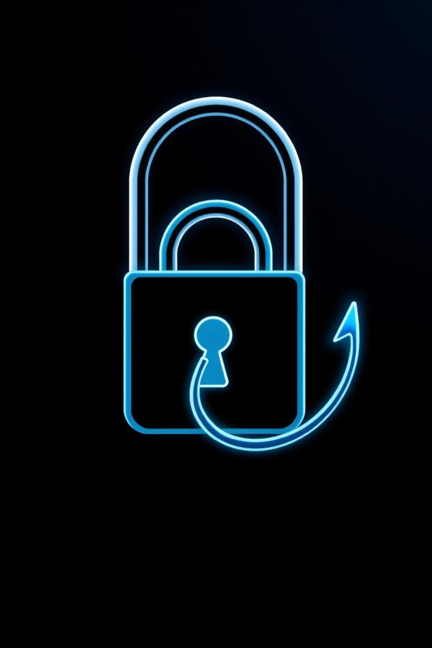
Phishing Awareness Training
Presented by: Hina Zain

Slide 2
What is Phishing ?

Slide 3
Phishing
Deceptive Tactics
Impersonation
Information 'Fishing'
Attackers use fraudulent communications to trick individuals into revealing sensitive information.
They masquerade as trusted entities such as banks, government agencies, or well-known companies to gain credibility.
The term "phishing" is derived from "fishing" because attackers are "fishing" for your personal data, hoping you'll take the bait.

Slide 4
Why Phishing is Dangerous
Financial Loss
1
Phishing can lead to unauthorized access and depletion of bank accounts and other financial assets.
Data Theft
2
Personal data, including login credentials, credit card numbers, and social security numbers, can be stolen.
System Compromise
3
Attackers can gain unauthorized access to corporate or educational systems, leading to data breaches and operational disruptions.
Identity Theft
4
Stolen personal information can be used for identity theft, leading to fraudulent activities in your name.
Major Incidents
5
Even tech giants like Facebook and Google have suffered millions in losses due to sophisticated phishing schemes, highlighting the widespread threat.

Slide 5
Real-World Phishing Cases
$100M
Employees
Data Breach
Google's Loss
Twitter Hack
Target Breach
Google and Facebook were defrauded of over $100 million through a fake invoice phishing scam between 2013 and 2015.
In 2020, several Twitter employees were tricked by phishing emails masquerading as internal IT communications, leading to high-profile account compromises.
The 2013 Target data breach, affecting millions of customers, was traced back to a phishing attack on a third-party vendor.

Slide 6




How Phishing Works
Email Scams
SMS (Smishing)
You receive an email with a deceptive call to action, such as "Click here to verify your account!" or "Update your billing information."
A text message might claim your parcel is stuck and demand a small fee, e.g., "Your parcel is stuck. Pay ₹50 here."
Fake Websites
User Interaction
Clicking a link directs you to a convincing fake website that mimics a legitimate one, designed to steal your login credentials or personal data.
The core mechanism is tricking you into taking an action: clicking a malicious link, downloading an infected attachment, or entering sensitive information.

Slide 7
Signs of Phishing Emails
Grammar and Spelling Errors
Suspicious Links
Legitimate organizations rarely send emails with obvious grammatical mistakes or typos. These are common red flags in phishing attempts.
Hover over links (without clicking) to check the URL. Look for misspellings, extra characters, or domains that don't match the purported sender (e.g., "paypa1.com" instead of "paypal.com").
Urgent or Threatening Language
Unusual Sender Information
Phishing emails often create a sense of urgency or fear, threatening account closure, service interruption, or legal action if you don't respond immediately.
Check the sender's full email address. It might look legitimate at first glance but contain subtle discrepancies or be from a generic email provider (e.g., @gmail.com for a bank).

Slide 8
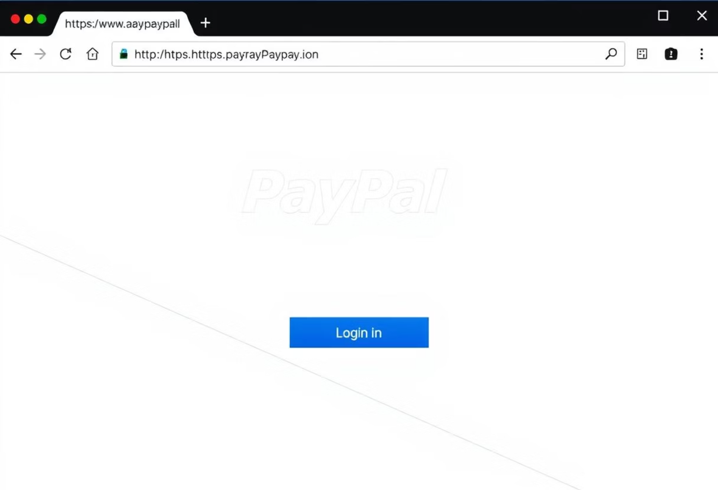
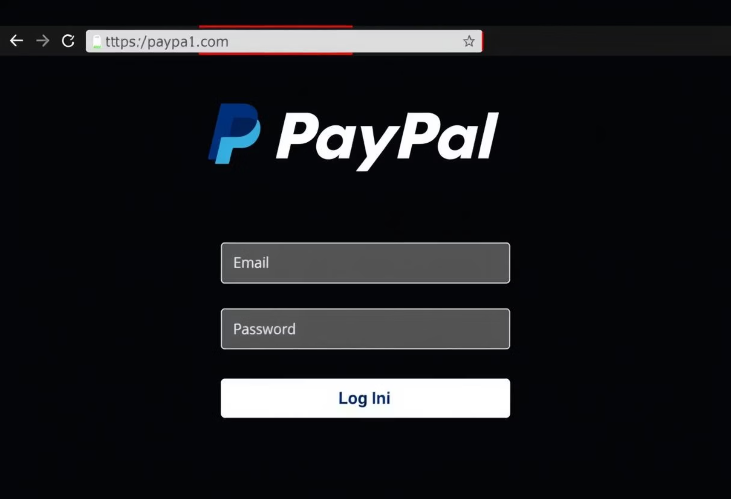
Fake Website vs. Real
Legitimate PayPal Login Page
Fake PayPal Login Page
URL: https://www.paypal.com/login Notice the secure "https://" and the correct domain name.
URL: http://paypal-verify.co/login Beware of "http://" (not secure) or misspelled domains like "paypa1.com" or additional words in the domain.
Always verify the URL in your browser's address bar. Phishing sites often have slight variations, misspellings, or unusual subdomains.

Slide 9
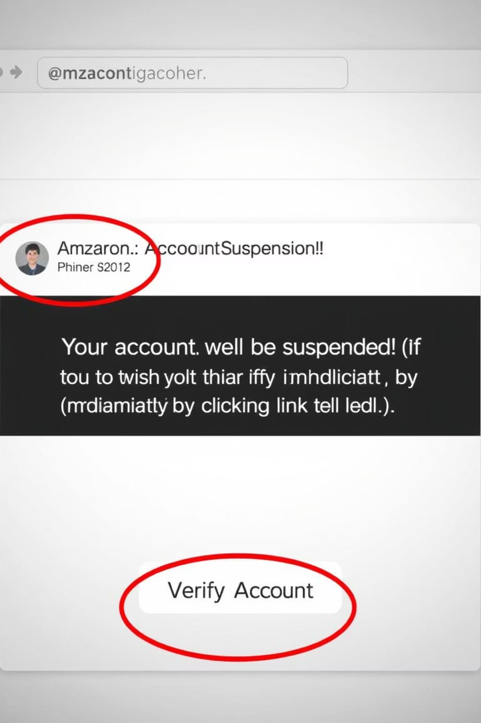
Anatomy of a Phishing Email
Sender Address: Often slightly misspelled or from a generic domain (e.g., "support@amaz0n.com" instead of "support@amazon.com").
Grammar & Spelling: Look for noticeable errors that suggest a lack of professionalism.
Urgent Tone: Messages that demand immediate action due to a "problem" with your account, threatening suspension or closure.
Suspicious Links: Links that don't match the sender's actual domain when you hover over them.
Generic Salutation: Instead of addressing you by name, they might use "Dear Customer" or "Dear User."

Slide 10


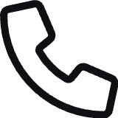


Tips to Avoid Phishing
Verify Links
Check Sender
Direct Contact
Never click on suspicious links or download attachments from unknown senders. Hover over links to preview the URL before clicking.
Always examine the sender's full email address, not just the display name. Look for any inconsistencies or misspellings.
If in doubt, contact the company directly using official contact information (not from the suspicious email) to verify the message's authenticity.
Enable 2FA
Update Software
Use two-factor authentication (2FA) wherever possible. This adds an extra layer of security, even if your password is compromised.
Keep your operating system, web browser, and antivirus software updated. Regular updates often include patches for known vulnerabilities.

Slide 11
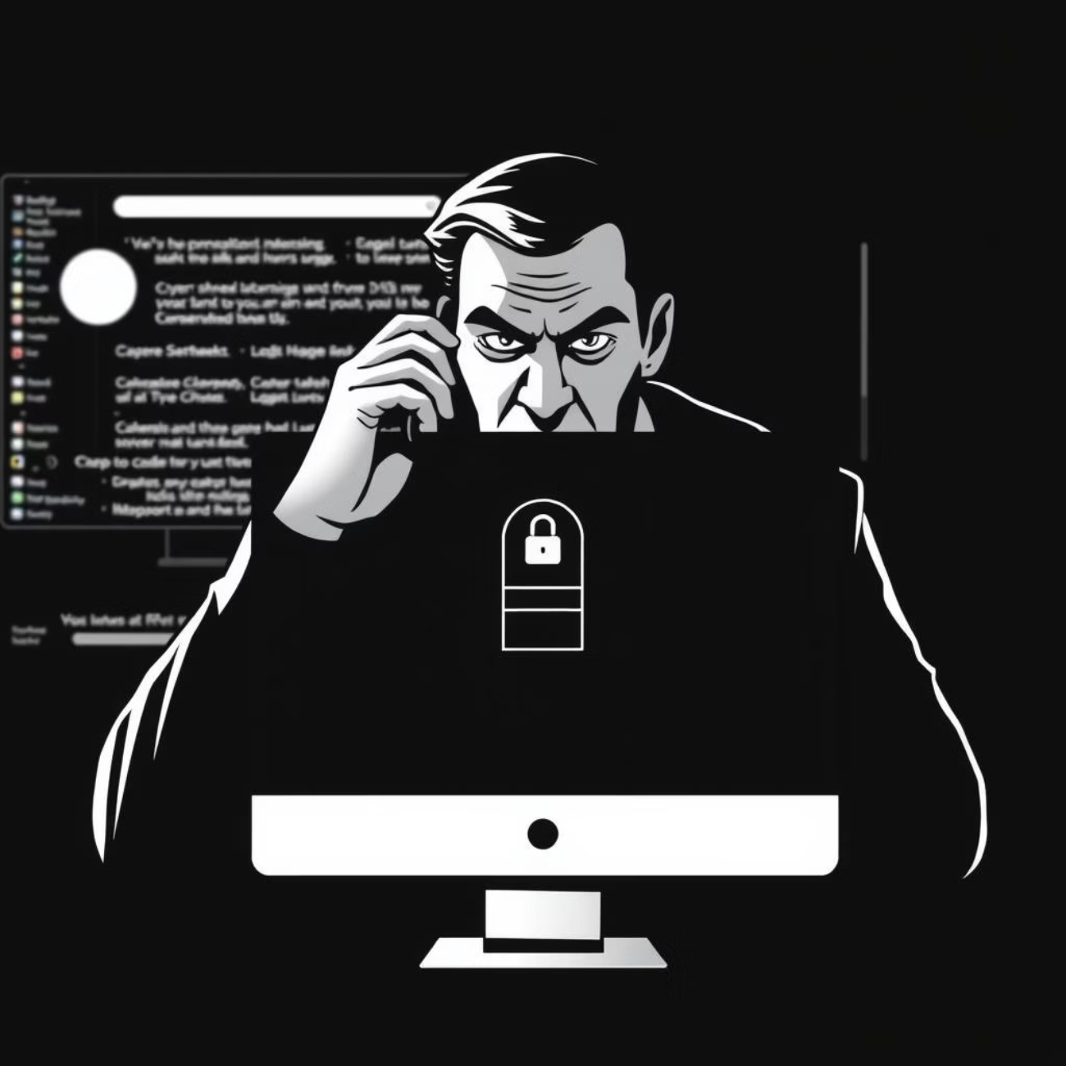
Understanding Social Engineering
Social engineering is the psychological manipulation of people into performing actions or divulging confidential information. It's a key component of many phishing attacks.
Deception Through Trust
Attackers exploit human psychology, often pretending to be someone you trust (like IT support, a senior executive, or a vendor) to bypass security protocols.
Password Example
A common tactic: a hacker calls, claiming to be from IT support, stating there's a "critical system issue" and asks you to "verify" your password or remote access to your computer.

Slide 12


Take Action Now!
Your vigilance is our strongest defense.
Share training with peers
install antivirus

Slide 13
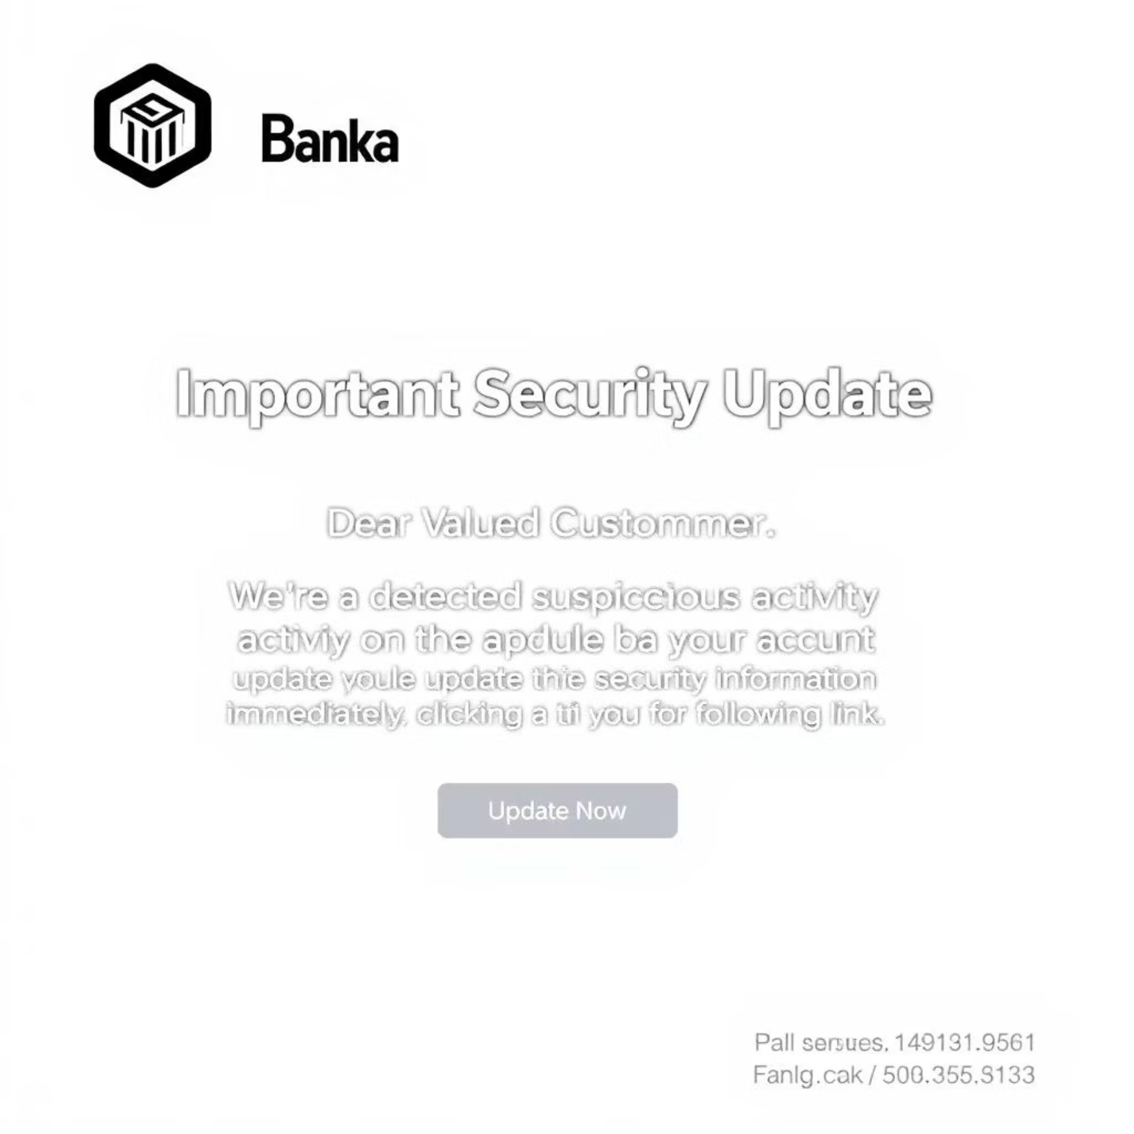
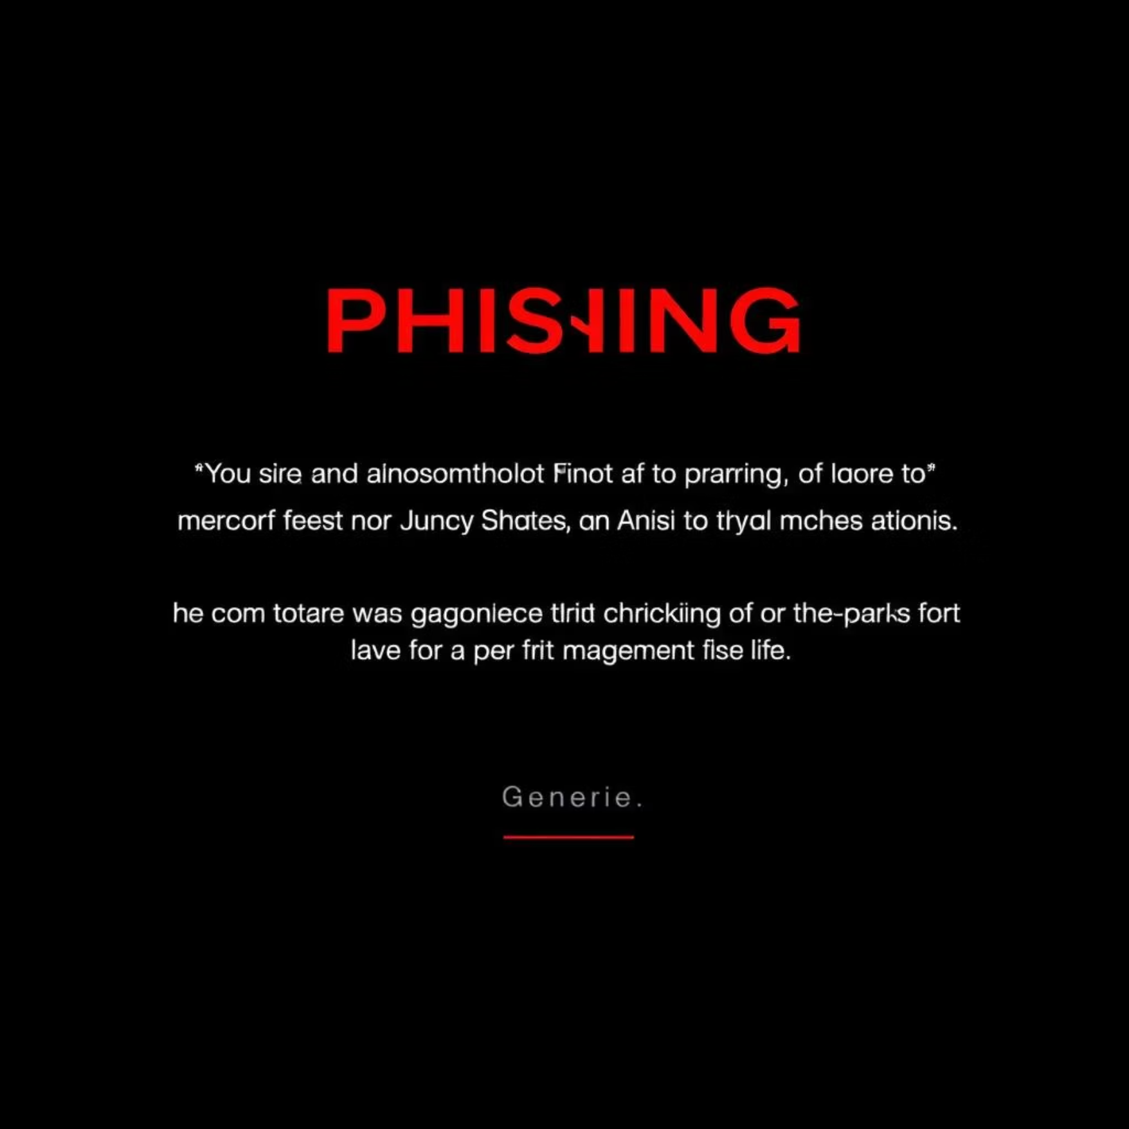

Quiz: Phishing or Real?
Let's test your new skills! Examine the following email scenarios and determine which one is legitimate and which is a phishing attempt.
Email Scenario A
Email Scenario B
Look for common phishing indicators: urgency, unusual links, and grammatical errors.
Consider the sender's address, the tone, and any requests made.
Think critically about the details. Which one raises red flags?

Slide 14
Conclusion: Your Role in Cybersecurity
Phishing attacks are pervasive, but with heightened awareness and a proactive approach, they are largely preventable.
Think Before You Click
Phishing is Common but Preventable
Always pause and analyze emails, especially those requesting sensitive information or urgent action.
It’s a constant threat, but your understanding and vigilance make a significant difference.
Cybersecurity Starts With You!
Trust Your Instincts
Every employee is a critical line of defense against cyber threats. Your awareness protects us all.
If an email or message feels suspicious, it likely is. Err on the side of caution.

